Slide 1

RAG-cipe
Mood -> Recipes
Ingredients -> Recipes
OCR -> Recipe
*Constrained to my
database of recipes

Slide 2
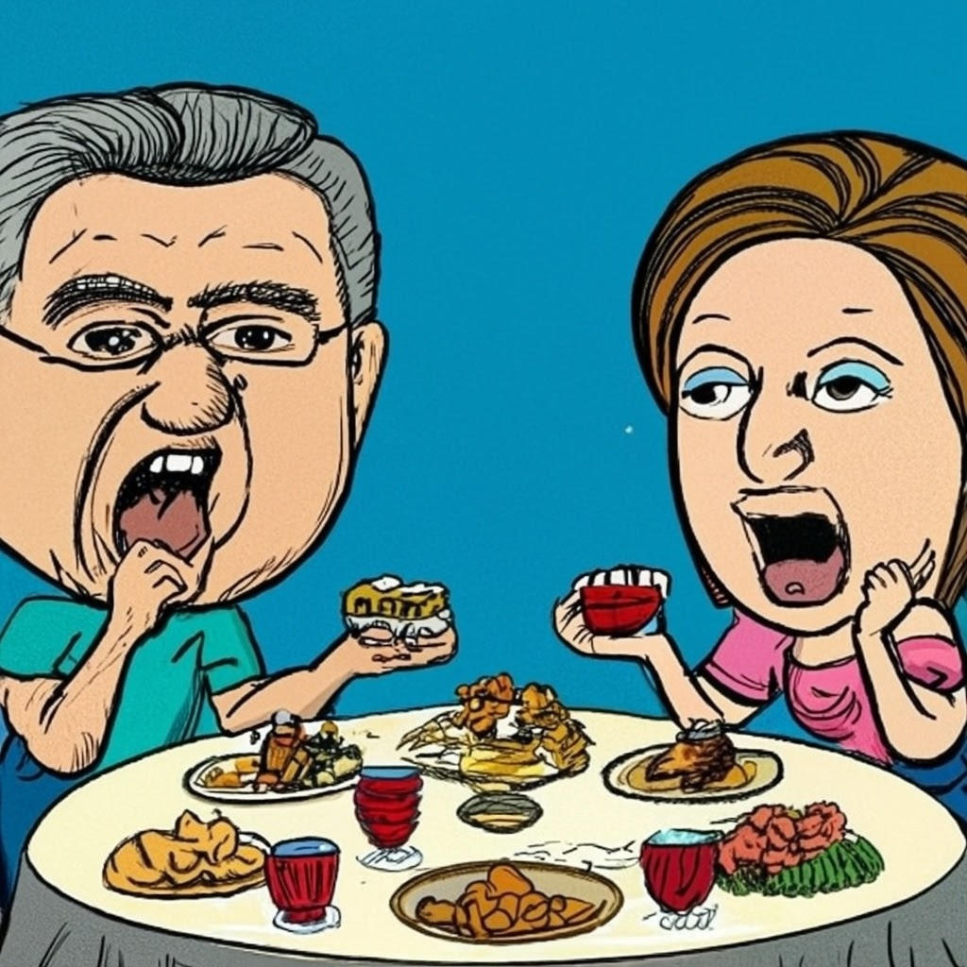
Mood -> Recipes
Me: What do you want for dinner ?
Her: What do you want for dinner ?
Me: Anything, what do you prefer ?
Her: Anything also…
Me: Some Chinese dumplings ?
Her: Nooooo
Me: Some burgers ?
Her: Nooooo
Me: Something Italian ?
Her: Sure !

Slide 3
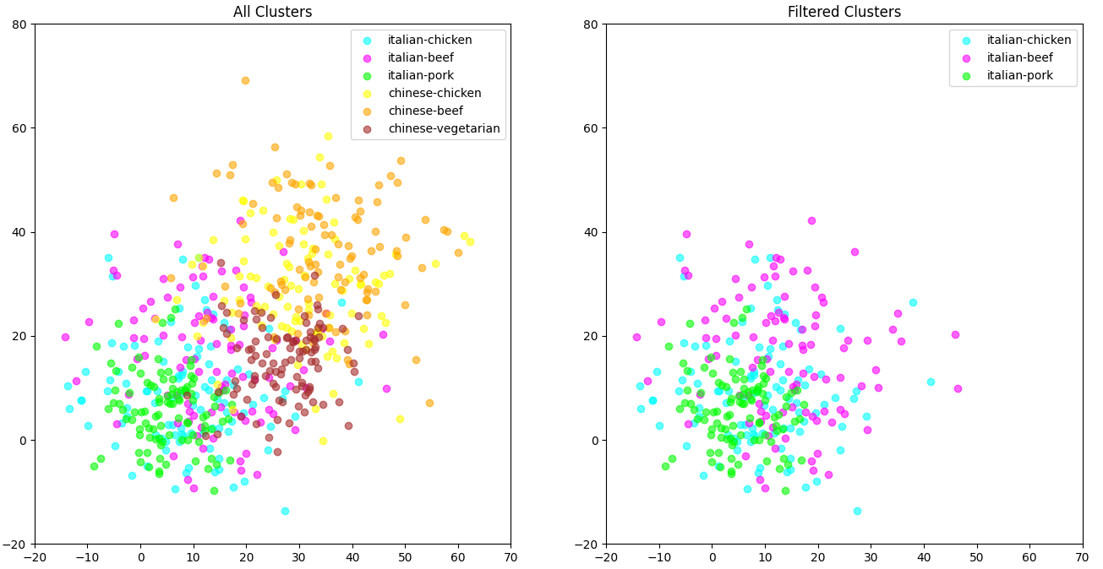
Want to reduce the search space

Slide 4
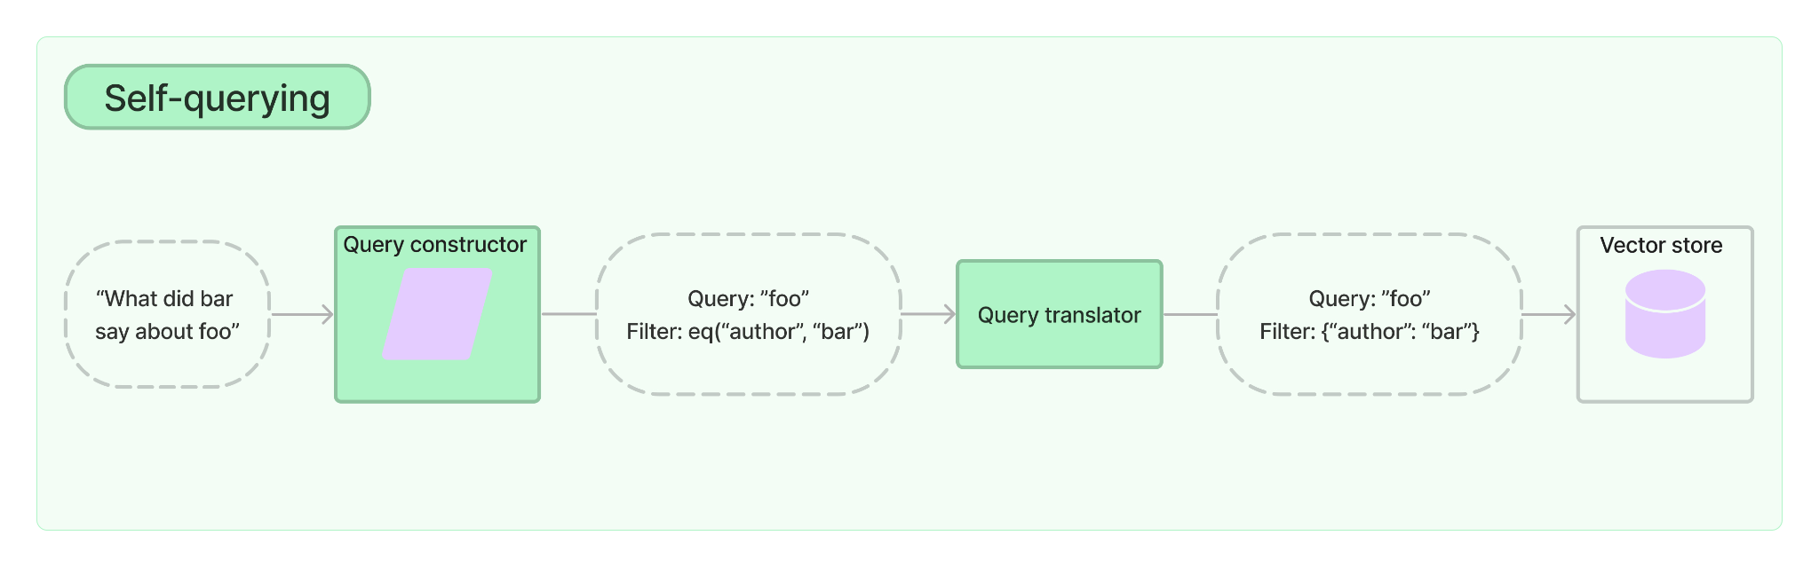
Self-querying retriever
Reduces search space before performing semantic search
RAGcipe - Self_querying_retriever.ipynb
https://python.langchain.com/docs/modules/data_connection/retrievers/self_query/

Slide 5
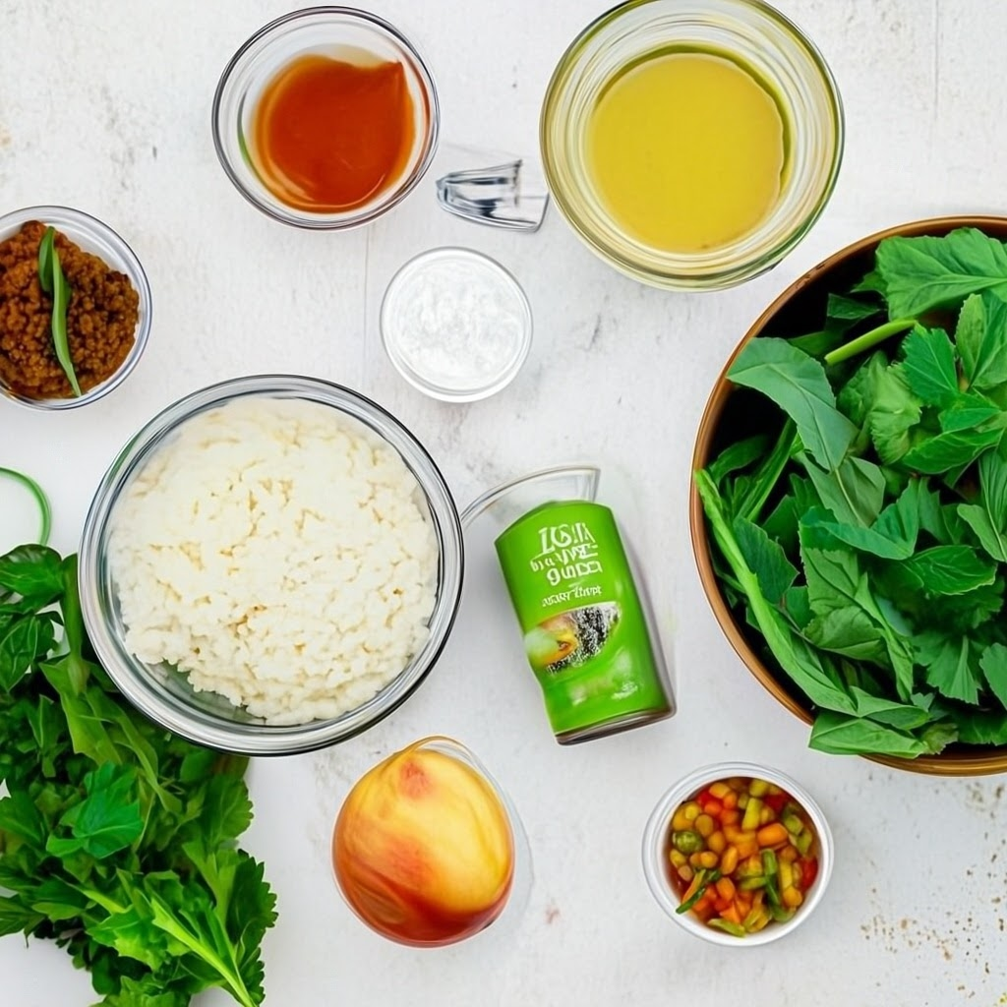
2) Ingredients -> Recipes

Slide 6
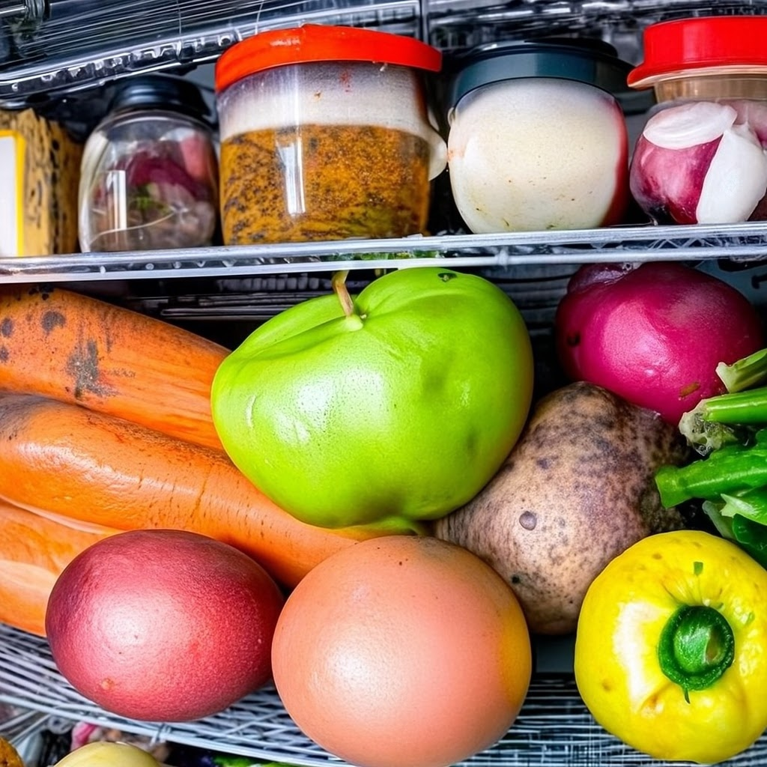
2) Ingredients -> Recipes
Problem Statement:
Want to clear the fridge (Expiring food)
Craving for a particular ingredient
Approach
Shortlist recipes based on ingredients
Exact keyword search
Semantic search

Slide 7
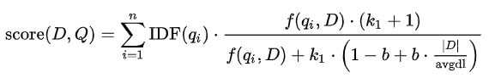
Ensemble Retrievers
Ingredient List
Penne
Prawn
Salt
Exact Keyword Search
Prioritise important words
Prawn ≠ {Crab, Mussels}
Deprioritise unimportant words
Salt
BM25
Semantic Search
“Fuzzy” search
Similar meaning
Pasta ≈ {Spaghetti, Penne, Linguine}
Reranking
Enable both exact and fuzzy search
Rerank: Reciprocal Rank Fusion (RRF)
Ensemble
BM25 retrieval
Semantic Search
Recipe 11
Recipe 1
Recipe 88
Recipe 2
Recipe 11
Recipe 99
Reranking
Recipe 11
Recipe 2
Recipe 1

Slide 8
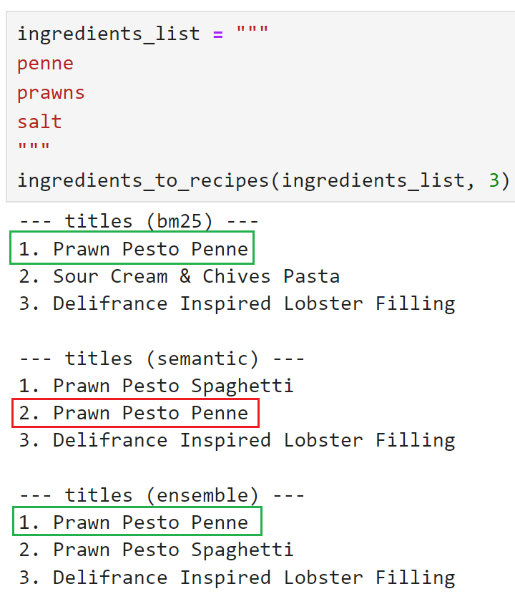
Exact Keyword Search > Semantic Search
Penne
Prawn Pesto Penne | Prawn Pesto Spaghetti | Delifrance Inspired Lobster Filling | Others…
prawns penne pesto paste | prawns spaghetti pesto paste | prawns lobster crabmeat tuna | …
pepper herbs chilli powder garlic olive oil butter | salt pepper herbs chilli powder garlic olive oil butter | mayo onion chili powder | salt …

Slide 9
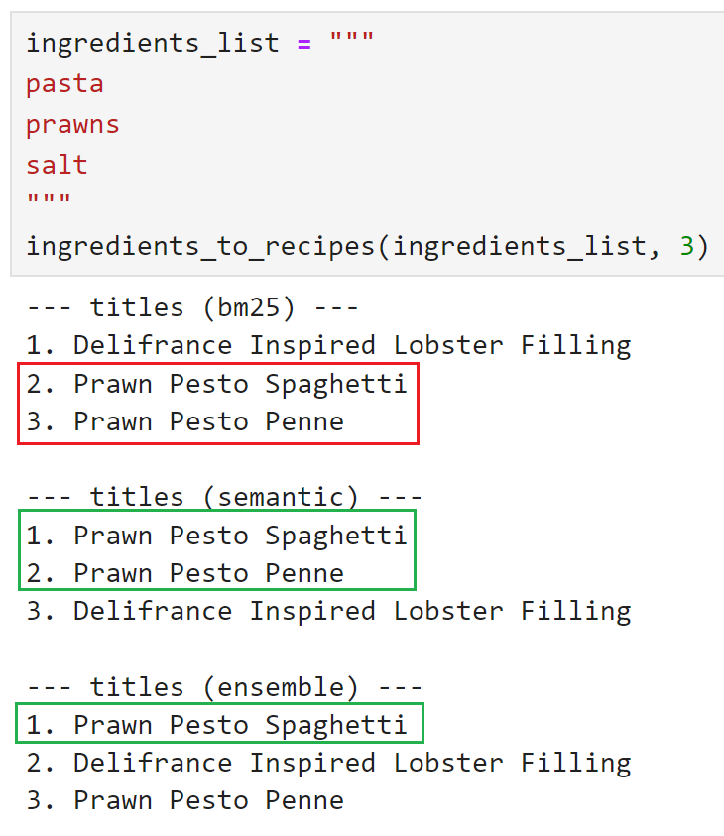
Exact Keyword Search < Semantic Search
Pasta ≈ {Spaghetti, Penne, Linguine}
Prawn Pesto Penne | Prawn Pesto Spaghetti | Delifrance Inspired Lobster Filling | Others…
prawns penne pesto paste | prawns spaghetti pesto paste | prawns lobster crabmeat tuna | …
pepper herbs chilli powder garlic olive oil butter | salt pepper herbs chilli powder garlic olive oil butter | mayo onion chili powder | salt …

Slide 10
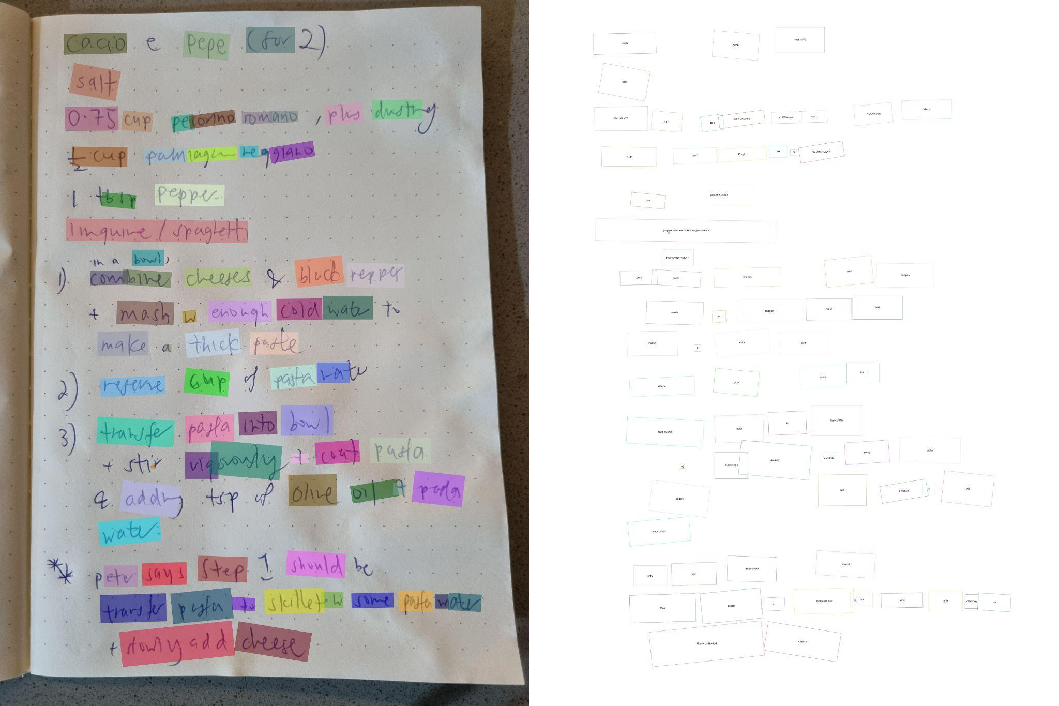
3) OCR -> Recipe

Slide 11
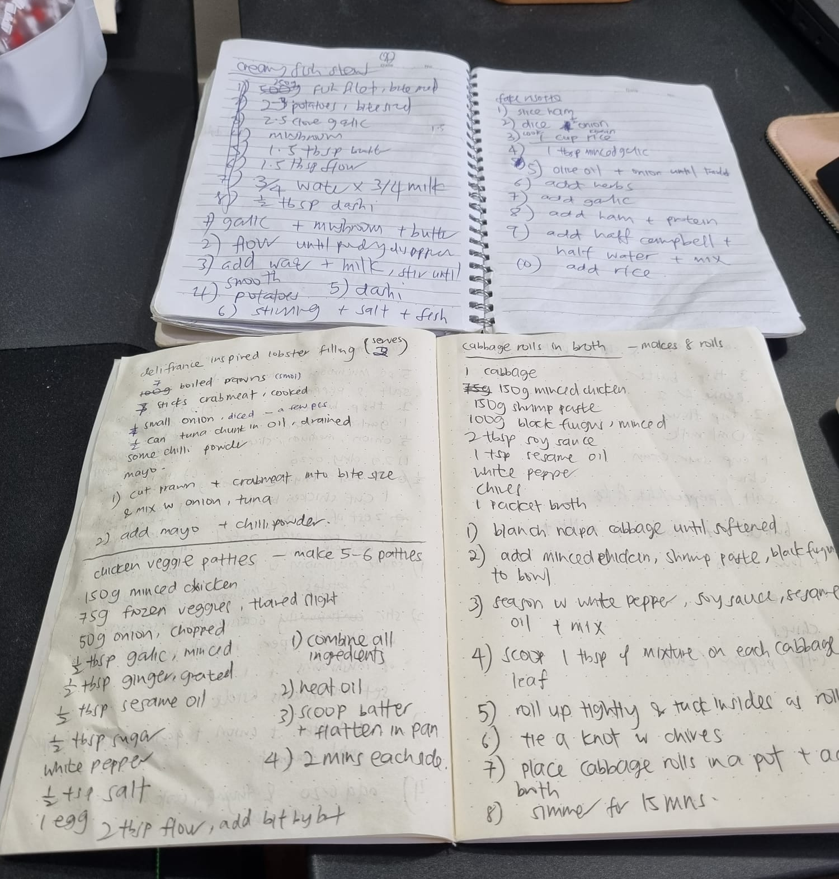
3) OCR -> LLM -> Recipe
Problem Statement:
Handwritten recipes
Passed down from generation
Legacy workflow
Draining to type manually
Optimize using OCR + LLM

Slide 12
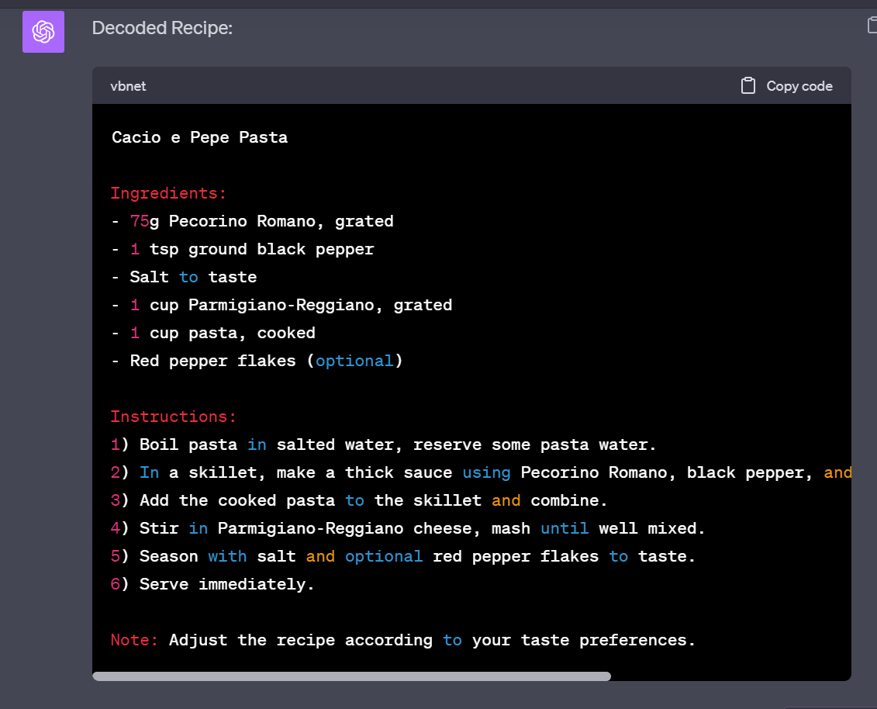
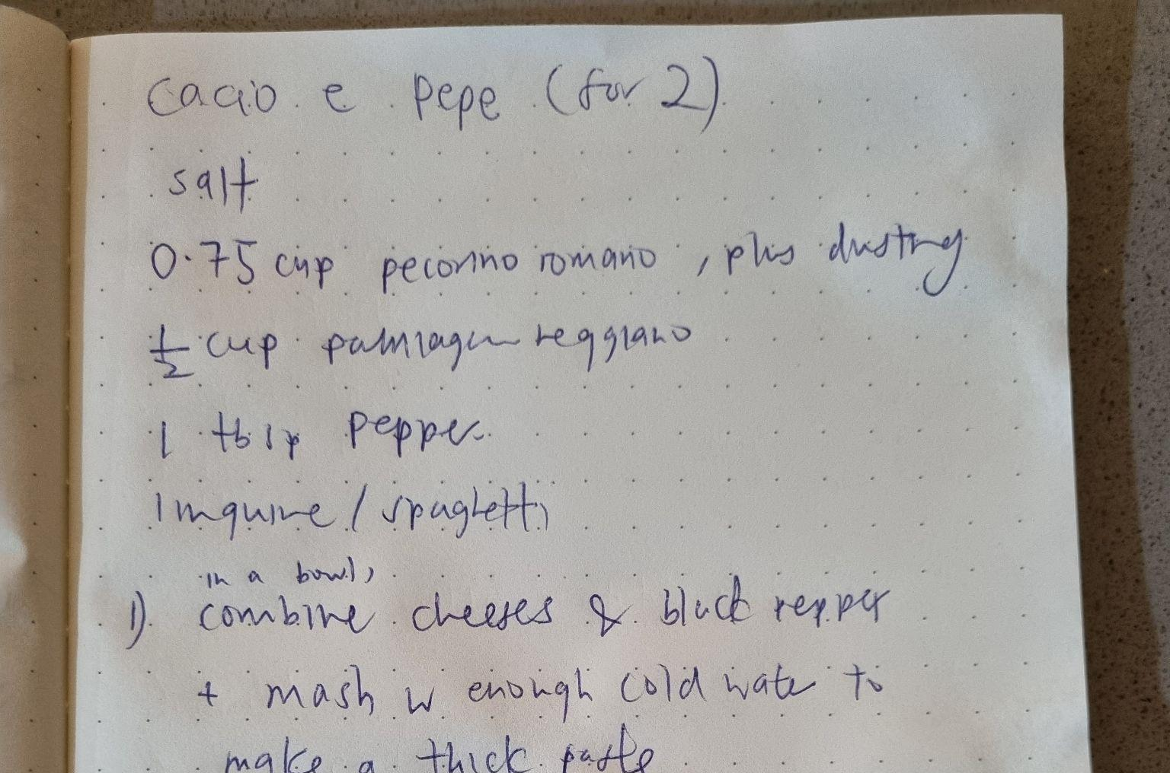
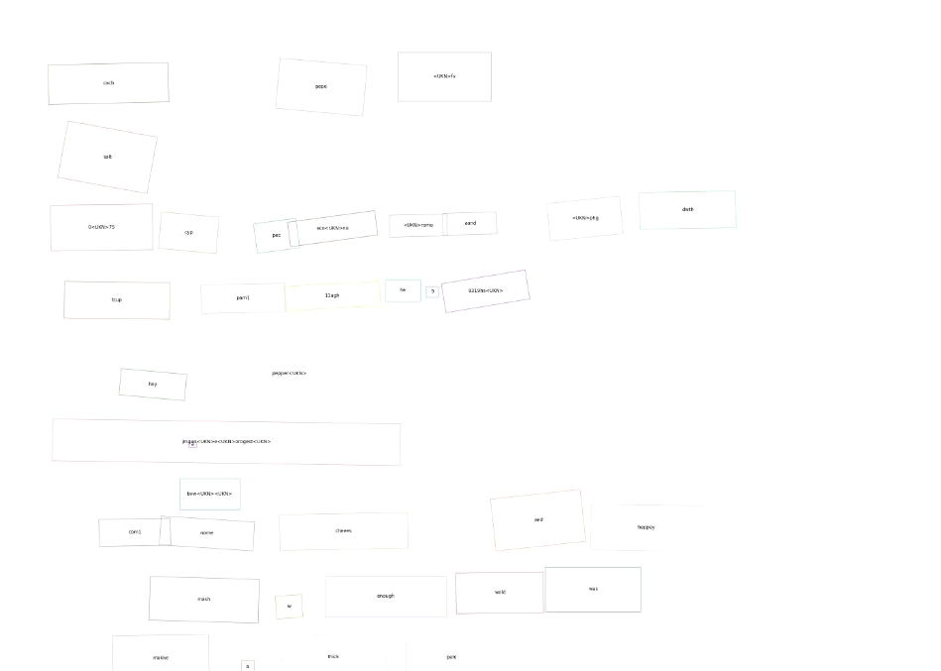
3) OCR -> LLM -> Recipe
Input Image
OCR + Postprocess
LLM

Slide 13
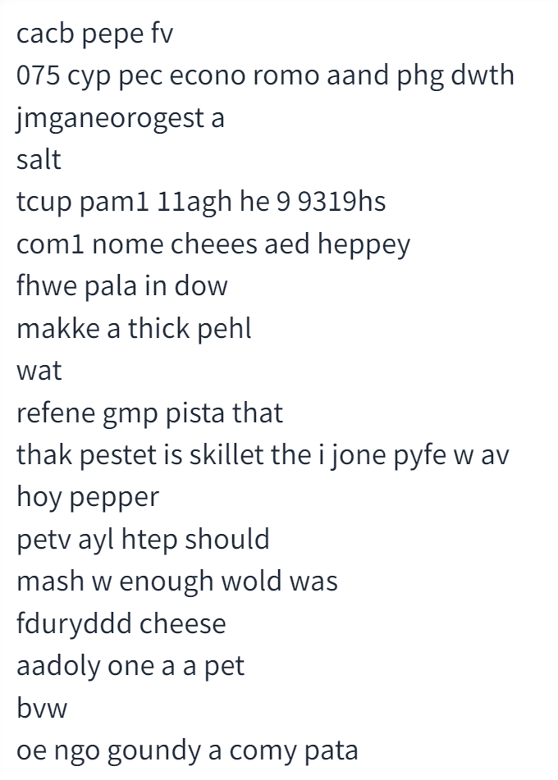
Query LLM
Can ChatGPT “decode” this recipe ?

Slide 14
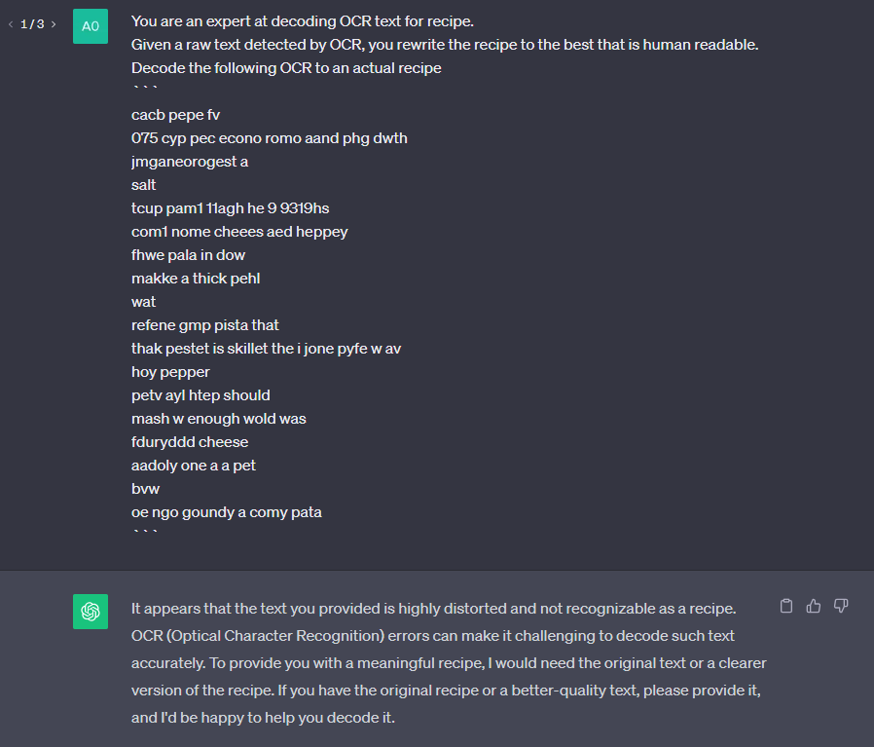
Zero-Shot

Slide 15
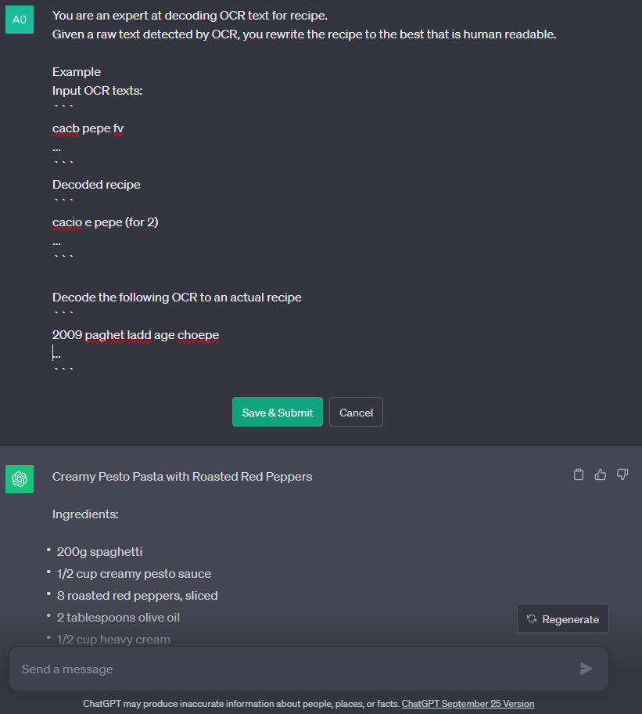
Few-Shot

Slide 16
Summary
Mood -> Recipes
Self Querying RAG
Ingredients -> Recipes
Ensemble RAG
OCR -> Recipe
Few shot
Ingredient List
Ensemble
BM25 retrieval
Semantic Search
Reranking
Input Image
OCR + Postprocess
LLM

Slide 17
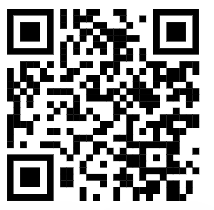
End
http://bit.ly/3QxQ8hy

Slide 18
BM25
q | word
D, |D|, avgdl | Document, Document length, age document length
f(q,D) | Frequency of word q in document D
IDF(q) | Inverse Document Frequency of word q Salt: common & unimportant, weigh it less Prawn: weigh important ingredient more
k ∈ [1.2, 2.0] | Higher: Weighs f(q,D) more relatively
b ≈ 0.75 | Higher: Weighs normalization of document length more
https://en.wikipedia.org/wiki/Okapi_BM25

Slide 19
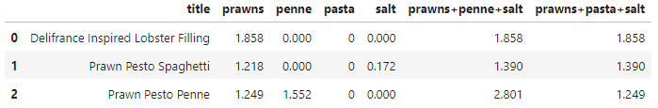
BM25
Prawn Pesto Penne | Prawn Pesto Spaghetti | Delifrance Inspired Lobster Filling | Others…
prawns penne pesto paste | prawns spaghetti pesto paste | prawns lobster crabmeat tuna | …
pepper herbs chilli powder garlic olive oil butter | salt pepper herbs chilli powder garlic olive oil butter | mayo onion chili powder | salt …

Slide 20
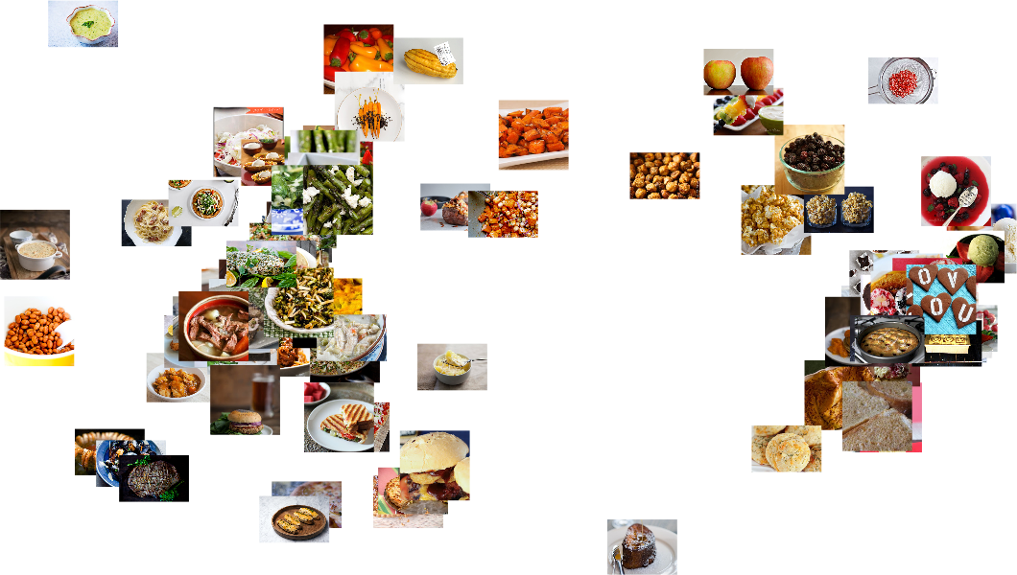
Semantic Search

Slide 21
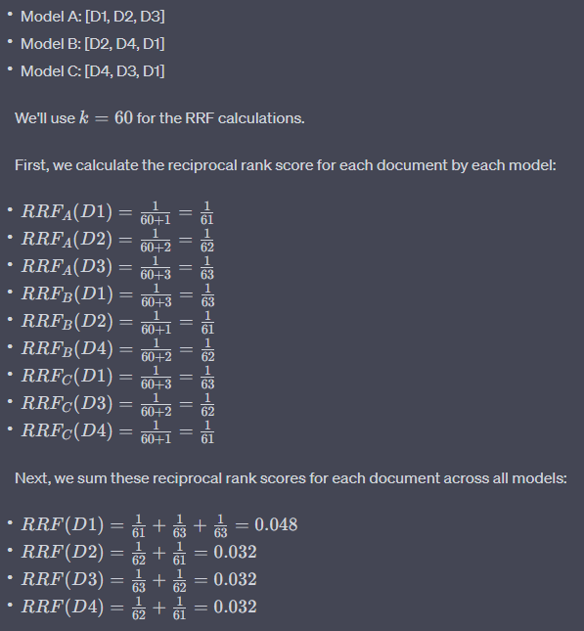
Ensemble Reranking (Reciprocal Rank Fusion)

